Slide 1

Netflix Cleaned Dataset
12.18.2024
By: Gabriel George

Slide 2
Agenda
Science Presentation
1.
Introduction
2.
Methodology
3.
Results
4.
Future Work
5.
Appendix

Slide 3
Agenda
Science Presentation
1.
Introduction
2.
Methodology
3.
Results
4.
Future Work
5.
Appendix

Slide 4
Key Question:
How do Netflix Originals compare to licensed content in terms of viewership trends, ratings, and popularity?

Slide 5
Purpose:
The purpose of this project is to analyze how Netflix Originals compare to licensed content in terms of viewership trends, ratings, and genre popularity.

Slide 6
Beneficiaries:
People who could benefit from this analysis include Netflix managers, marketing teams, content creators, and investors. The results can help them make better decisions about content and audience strategies.

Slide 7
Agenda
Science Presentation
1.
Introduction
2.
Methodology
3.
Results
4.
Future Work
5.
Appendix

Slide 8
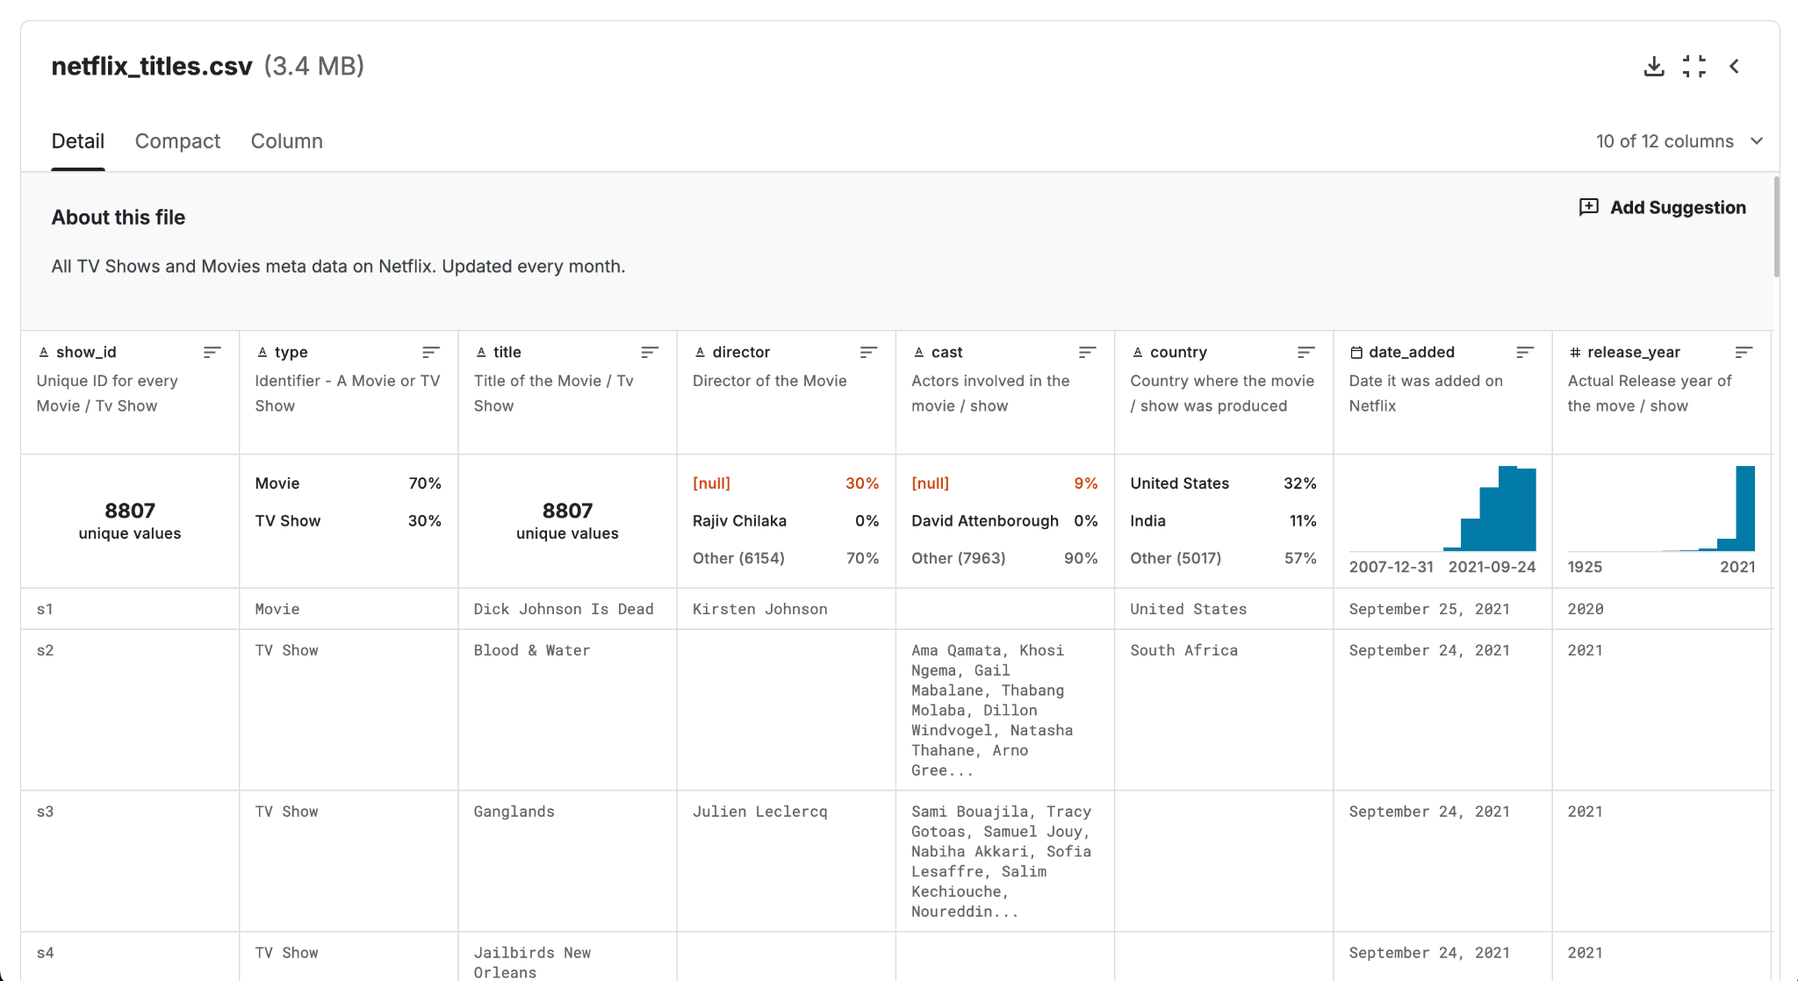
Netflix Dataset

Slide 9
An individual sample is a Netflix title, characterized by features such as rating, genre, release year, content type (Original/Licensed), country, duration, date added, and other relevant attributes from the dataset.

Slide 10
I used Python with libraries like Pandas for data manipulation, Matplotlib and Seaborn for visualizations, and Jupyter Notebook as the environment to analyze and present data throughout the project.

Slide 11
Agenda
Science Presentation
1.
Introduction
2.
Methodology
3.
Results
4.
Future Work
5.
Appendix

Slide 12
Insights:
The analysis showed Netflix Originals dominate over licensed content, with varied genre preferences and a balanced rating distribution, raising further questions about regional performance and genre correlations.

Slide 13
Yes, the analysis answered important questions about content trends and ratings. It also brought up new questions about regional preferences, how different genres perform, and how long content lasts.

Slide 14
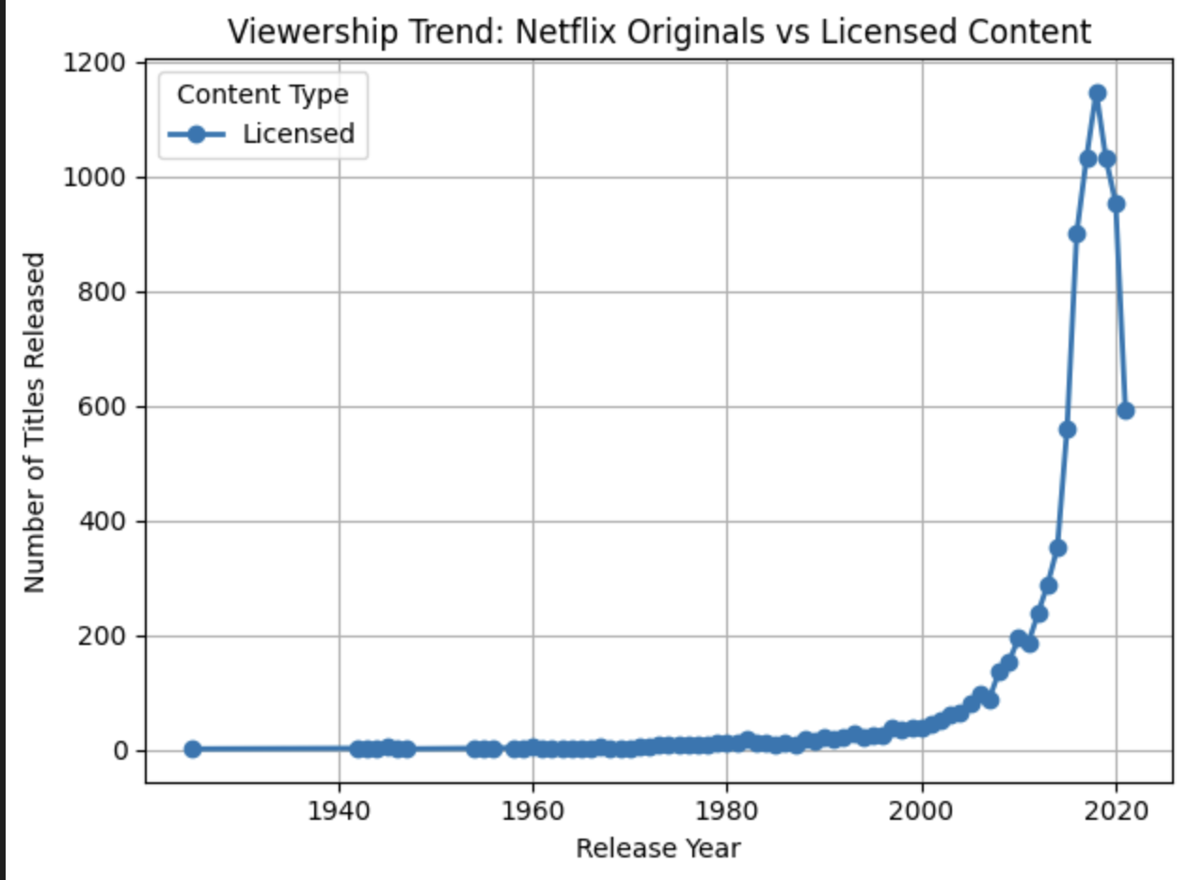
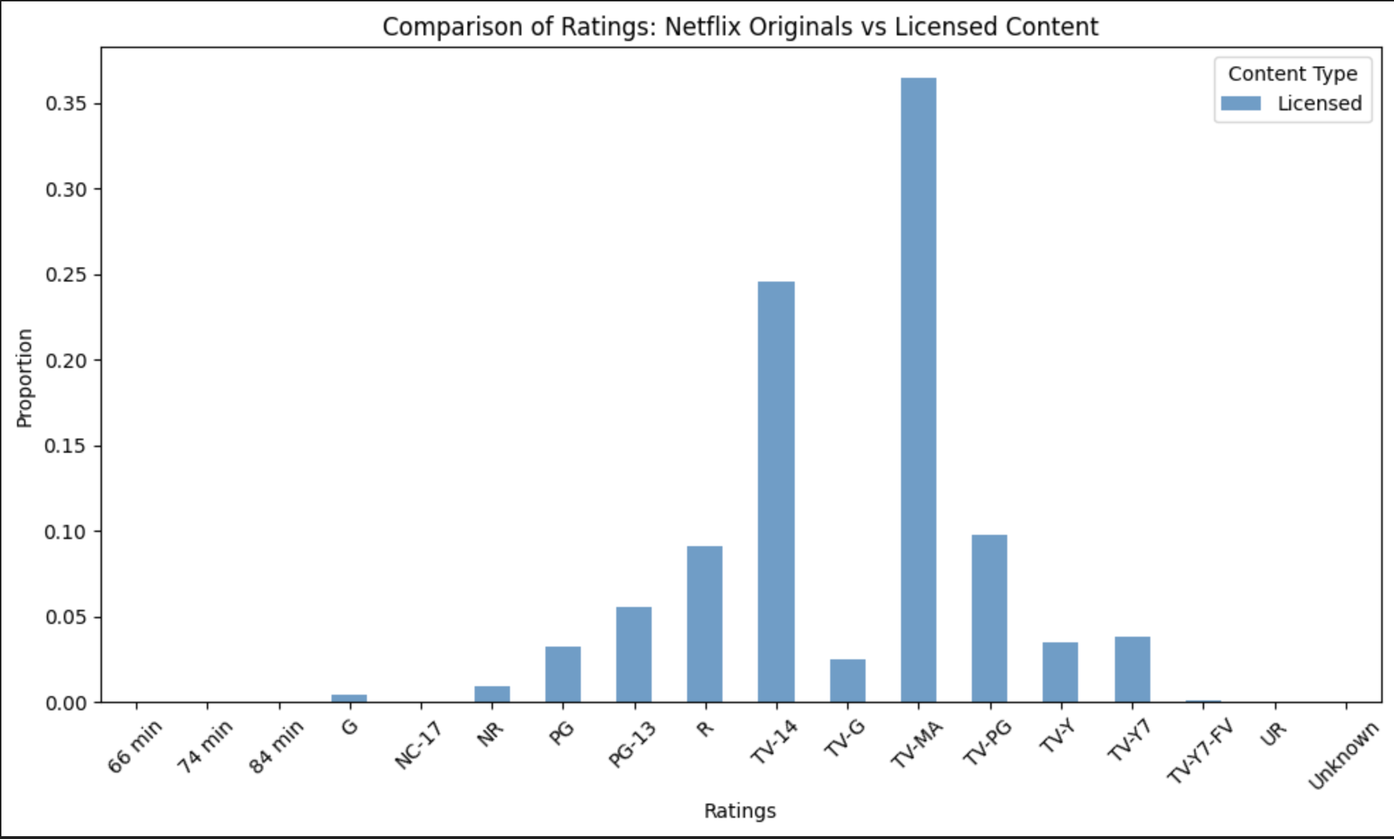
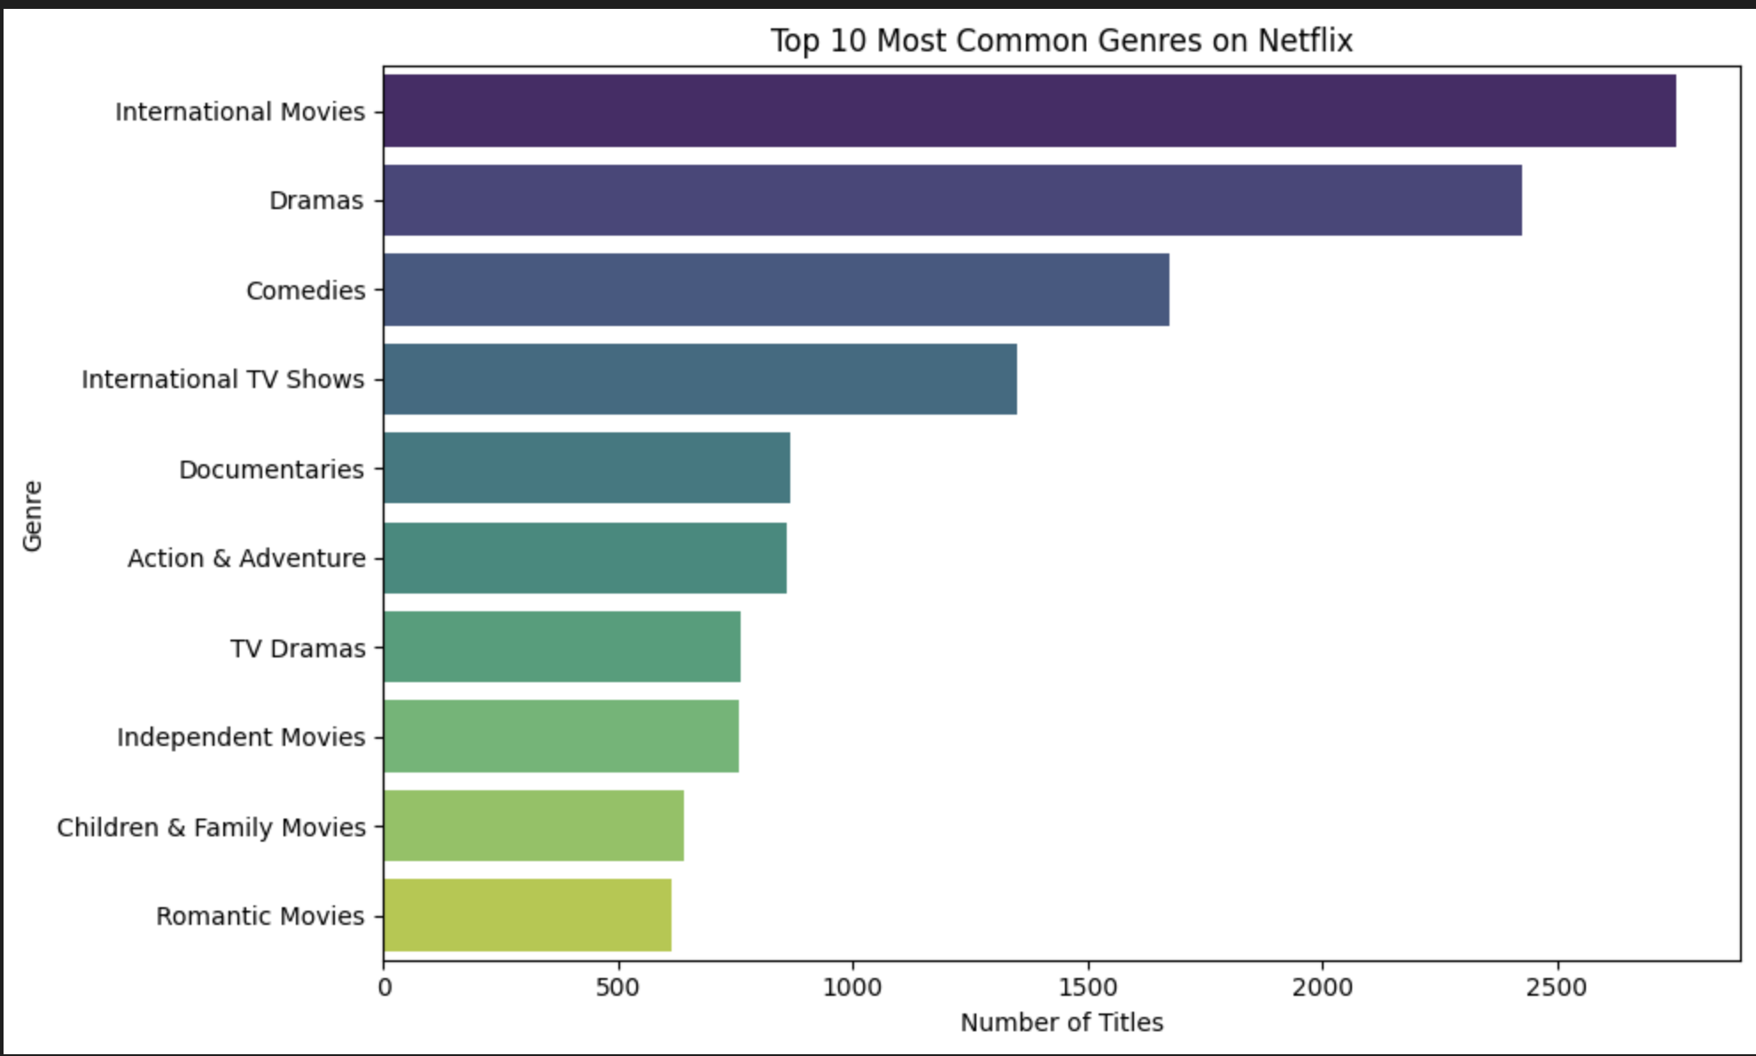

Slide 15
Agenda
Science Presentation
1.
Introduction
2.
Methodology
3.
Results
4.
Future Work
5.
Appendix

Slide 16
I would explore:
regional content preferences
analyze the impact of content type on viewership
investigate genre popularity over time
examine the influence of release date on ratings.

Slide 17
Questions that remain include:
how Netflix’s algorithm influences content recommendations
the impact of release timing on viewership
and how ratings correlate with long-term popularity and user engagement.

Slide 18
Agenda
Science Presentation
1.
Introduction
2.
Methodology
3.
Results
4.
Future Work
5.
Appendix

Slide 19

